Slide 1
HarvestTrust
Farmer Producer Group Produce Collection and Payment Register
Every delivery recorded. Every payment explained.
Student
Institution
Janarthanan V
Reg. No: 411723205021
PSVPEC – Information Technology
IV Year | SIH 2026 – Internal Practical Assessment

Slide 2

Paper Slips Create Delays, Errors and Disputes
Existing Process
Main Problems
Farmer delivers produce at the collection point
Operator records quantity and rate on a paper slip
Slips are collected and processed later
Payments are calculated manually
Paper slips may be lost, damaged, or entered incorrectly
Manual calculation delays farmer payments
Farmers cannot immediately verify their delivery records
Quantity and rate disagreements are difficult to investigate
No reliable history of corrections or status changes
Secretary must manually scan records to find cases requiring attention
Key Research Insight: Farmer Producer Organisations aggregate member produce and manage agricultural supply-chain activities — reliable records are essential for transparent member transactions and group governance. FAO research identifies productivity, cost efficiency, market access, and inclusion as potential benefits of digital agriculture, while noting that rural connectivity and digital skills must be considered.

Slide 3
One Digital Record from Delivery to Payment
HarvestTrust records every delivery immediately, calculates what the farmer is owed, and provides a clear statement of deliveries, payments, and balance.
Core Capabilities
Before vs After HarvestTrust
Register every delivery against the correct farmer
Capture produce, collection point, quantity, unit, rate, date, and quality details
Calculate the authoritative amount on the server
Generate a unique digital receipt
Maintain rate, status, payment, and audit history
Search and filter the collection register
Show cases requiring attention first
Generate member delivery and payment statements
Predict whether a delivery may need manual review
Before HarvestTrust
With HarvestTrust
Paper collection slip
Searchable digital record
Manual calculation
Server-calculated amount
Difficult verification
Receipt and member statement
Overwritten information
Complete change history
Manual record scanning
Attention-first queue
Unclear outstanding amount
Updated payment balance

Slide 4
Simple, Reliable and Auditable Architecture
Technology Stack by Layer
Layer
Technology
Responsibility
Frontend
React, TypeScript, Tailwind CSS
Responsive screens and user interactions
Animation
Framer Motion
Page, card, receipt, and loading animations
Backend
Node.js, Express, TypeScript
Validation and business logic
Validation
Zod
Server-side field validation
Database
SQLite with Prisma ORM
Structured data, relationships, and history
Prediction
Python and scikit-learn
Attention-risk classification
Testing
Vitest, Supertest, Pytest
UI, API, database, and model verification

Slide 5
Important Technical Decisions
Design Principles
Main Database Entities
All important fields are validated on the server
Amount is calculated on the backend — not trusted from the browser
Delivery, history, prediction, and audit data are saved in one transaction
Rate and status changes are stored in history tables
Fixed-precision decimal values are used for money and quantity
The ML service can fail without preventing a valid collection from being saved
Core
Transactions
User · Member · Produce Type · Collection Point
Delivery · Payment · Payment Allocation
History & Audit
Intelligence
Rate History · Delivery Status History · Audit Log
Prediction · Attention Outcome

Slide 6
One System, Three Clear Responsibilities
Collection Operator
Group Secretary
Administrator
Sign in
Open Record Collection
Select farmer and produce
Enter quantity and rate
Review calculation and risk result
Submit and generate receipt
Sign in
Review dashboard and attention queue
Investigate high-priority records
Resolve or flag for follow-up
Open member statement
Record payment and update balance
Sign in
Manage members and users
Manage produce types and collection points
Create effective-dated rates
Review audit information

Slide 7
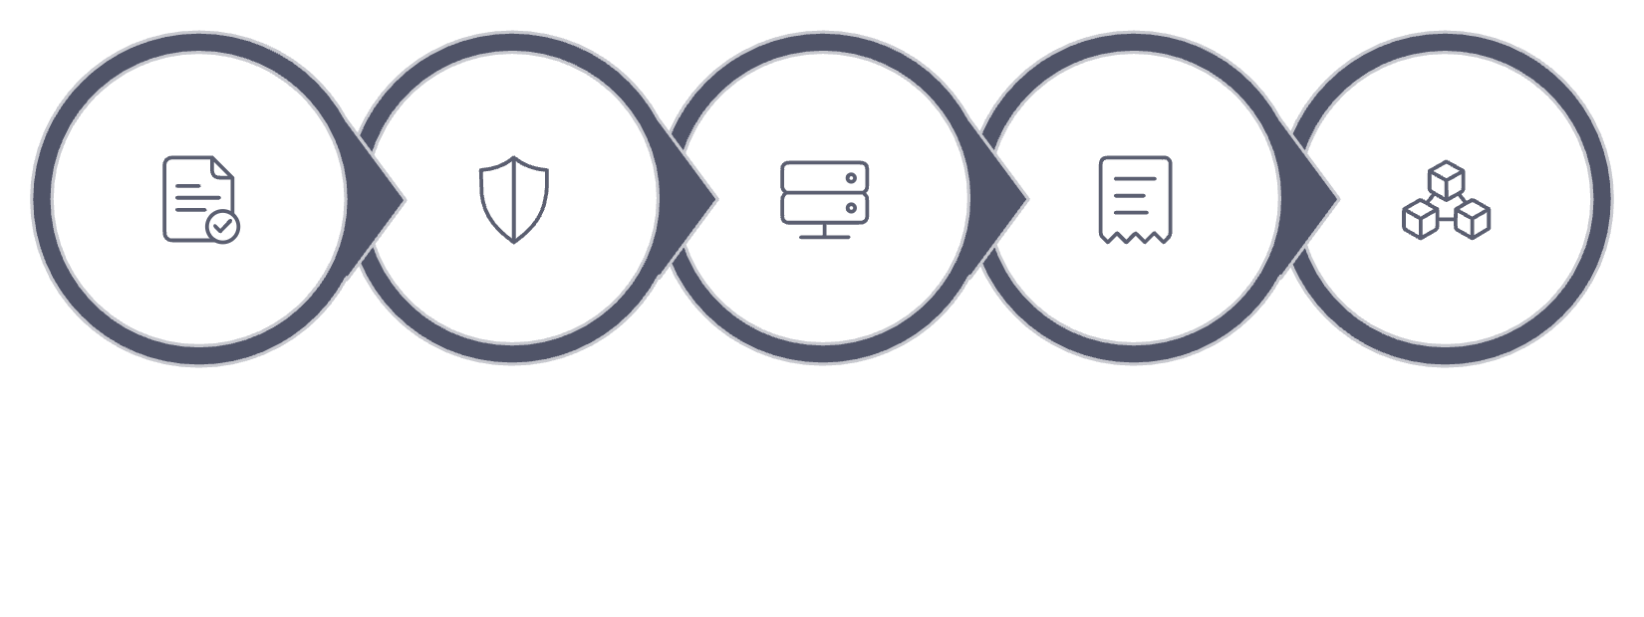
From Collection Entry to Trusted Statement
End-to-End Working Flow
Calculation Verification
Quantity = 125.50 kg | Rate = ₹32.40 per kg
Amount = 125.50 × 32.40 = ₹4,066.20
The browser may show a live preview, but the backend calculates and stores the final authoritative amount.
Enter Delivery
Risk Prediction
Submit & Calculate
Save & Receipt
Update Registers
Prediction Logic
Model predicts whether the collection may need manual attention
Uses only information available at the time of collection — no future data
If confidence ≥ 65%: shows risk band and probability
If confidence < 65%: displays "No confident prediction — review normally"
The secretary makes the final decision

Slide 8
More Transparency, Faster Review and Greater Trust
Benefits for Farmers
Expected Operational Impact
Immediate confirmation of quantity and rate
Clear receipt for every delivery
Transparent payment and balance statement
Easier resolution of disagreements
Greater confidence in the producer group
Area
Expected Improvement
Record accuracy
Server validation and structured fields
Calculation consistency
One backend calculation for every user
Benefits for the Producer Group
Payment transparency
Delivery, payment, and balance shown together
Fewer manual calculation errors
Faster collection and payment processing
Searchable records instead of paper bundles
Clear responsibility and audit history
Attention cases automatically prioritised
Dispute handling
Receipt, timeline, and audit evidence available
Secretary workload
High-priority cases displayed first
Reporting
Searchable and exportable digital data

Slide 9
Current Status and Next Steps
Current Completion
Next Improvement
End-to-end collection flow
Database design and history
Search, filters, ordering, and counts
Member statements and payments
Prediction integration and confidence threshold
Validation and integration tests
Add offline-first collection and SMS/WhatsApp receipts so the system remains useful at collection points with weak connectivity.
Offline-First
SMS / WhatsApp Receipts
Collection continues without network access; syncs when connectivity is restored
Farmers receive delivery confirmation directly on their mobile device

Slide 10
Research Foundation and Technical References
Farmer Producer Organisation Context
Machine-Learning Method
SFAC defines a Farmer Producer Organisation as a producer organisation whose members are farmers
SFAC's strategy paper describes Farmer Producer Companies as aggregation tools designed to support professional management and agricultural supply-chain activities
These findings support the need for transparent member, produce, delivery, and payment records
scikit-learn's train_test_split supports reproducible training and test subsets using a fixed random_state
Logistic Regression is a standard regularised classifier suitable for a simple, explainable binary prediction
A confidence threshold avoids presenting uncertain output as a definite decision
References
Digital Agriculture Context
SFAC. "Frequently Asked Questions – Farmer Producer Organisations." sfacindia.com
SFAC. "Strategy Paper for Promotion of 10,000 Farmer Producer Organisations." sfacindia.com
FAO. "Digital Technologies in Agriculture and Rural Areas – Status Report." 2019. fao.org
World Bank. "Digital Farm." worldbank.org
scikit-learn. train_test_split Documentation. scikit-learn.org
scikit-learn. LogisticRegression Documentation. scikit-learn.org
FAO reports that digital agriculture can support productivity, cost efficiency, market opportunities, communication, and inclusion
FAO highlights connectivity, affordability, digital skills, and institutional support as important conditions
The World Bank's Digital Farm project used farmer-friendly digital logbooks and returned information to farmers and producer organisations
HarvestTrust converts paper-based collection into a transparent digital relationship between farmers and their producer group.

